Slide 1

Human Trafficking Data Analysis
Project 1:
Elizabeth Harrison
Lisa Jemmings
Shirley Limburg;
Saron Raut
Mara Schemel
Sumit Patel

Slide 2
Fight the Plague of Human Trafficking
USA Human Trafficking Statistics 2.7 per 100k – 11,500 human trafficking cases reported in 2019 https://worldpopulationreview.com/state-rankings/human-trafficking-statistics-by-state
Worldwide, an estimated 20.8 million people are victims of human trafficking, contributing to an industry that generates more than $150 billion in illegal profits. https://www.dhs.gov/sites/default/files/publications/4146_CombattingHumanTraffickingThroughSocialScience.pdf
Third point
Fourth point
Questions you found interesting and what motivated you to answer them - Sumit

Slide 3
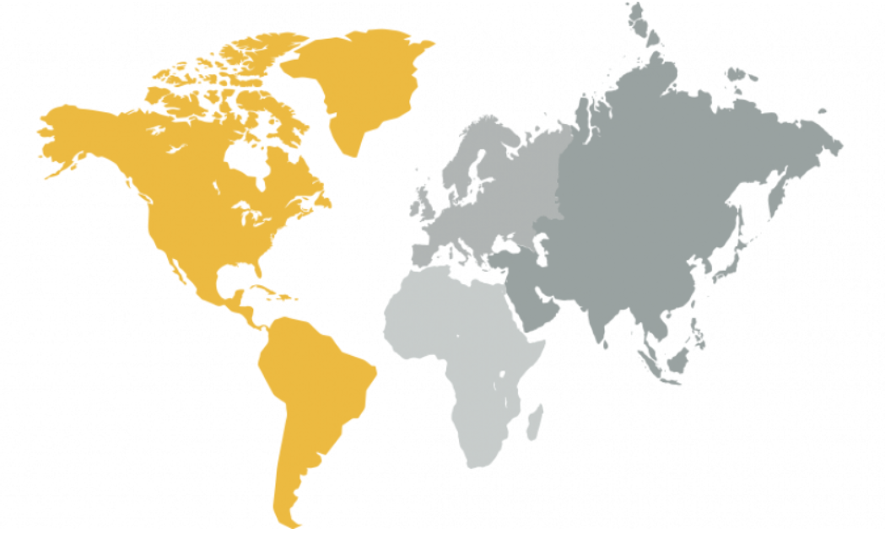
Counter Trafficking Data Collaborative and World Bank
Where and how you found the data you used to answer these questions - Saron

Slide 4
Data Integrity Could be Improved
Dataframe showing unknowns
Country names were not identical between datasets. For GDP the .csv source file was edited to make country names match to merge data
Another example
Venn diagram of world wide estimates vs reported cases
The data exploration and cleanup process (accompanied by your Jupyter Notebook) -Mara

Slide 5
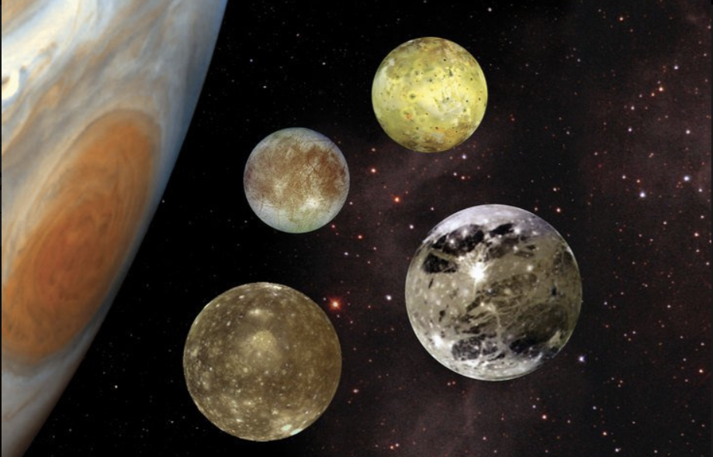
The Approach
Jupyter Notebook excerpts
The analysis process (accompanied by your Jupyter Notebook) - Liz

Slide 6
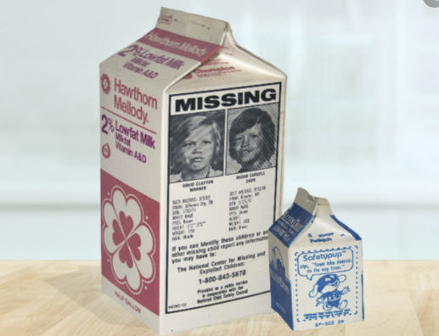
What We Found
Ages trafficked
graph
Industries graph
Your conclusions, which should include a numerical summary and visualizations of that summary - Lisa

Slide 7
What Else We Found
Economics graphs?
Other data
Your conclusions, which should include a numerical summary and visualizations of that summary -Lisa_

Slide 8
Lessons Learned
“Human trafficking is a heinous crime happening all around us. The victims—30% of which are children—are subject to forced labour, sexual exploitation and other forms of abuse. We must do more to bring criminals to justice, and help victims rebuild their lives. “ António Guterres
Secretary General of the United Nations
Need help? United States:
1 (888) 373-7888
National Human Trafficking Hotline
SMS: 233733 (Text "HELP" or "INFO")
Hours: 24 hours, 7 days a week
Languages: English, Spanish and 200 more languages
Website: humantraffickinghotline.org
The implications of your findings: what do your findings mean? - SHirley

Slide 9
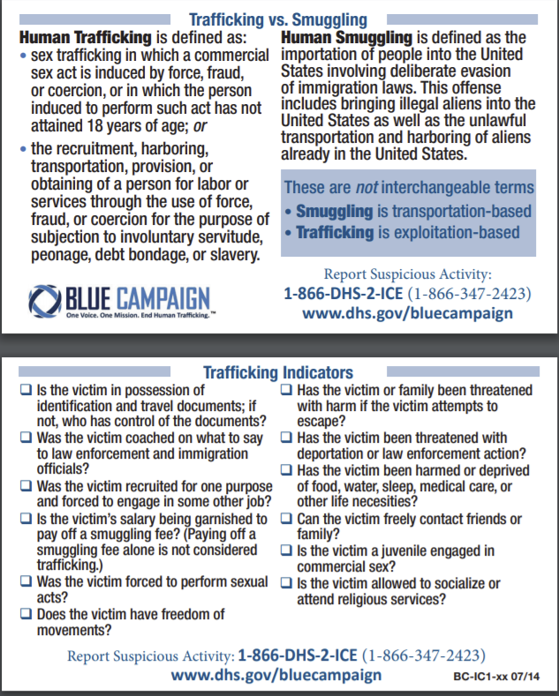
Appendix
US DHS
Add additional info here
https://www.dhs.gov/sites/default/files/publications/20_0115_plcy_human-trafficking-forced-labor-child-exploit-strategy.pdf

